Slide 1
OC - Project 3
Conception of the App Nutristeph
Exploratory Data Analysis
Of a
Food Database
Stephane Lanchec

Slide 2
NutriSteph
Application that returns the Nutriscore & Nutrigrade of products
What’s new?
No need for a food database
Works for non-referenced products
Works for any product across the globe
Just take a picture of the list of ingredients on the product
Integrated algorithm: Nutrients Nutriscore/grade
Integrated dictionary/translator to grade any product in the world
Users language choice

Slide 3
App Scientific Process
USERS
DATABASE
Data Cleaning
Nutriscore
PNNS categories
Nutrients
Nutrients
Products
PNNS Categories
Nutriscore
STEP 1:
Linear Regression
R²
^{Coef.}
^{of determination}
STEP 2:
One Hot Encoding
Uni/Multivariate
Analysis
Statistical tests
Data
Exploration
Linear regressions

Slide 4
Dataset Overview & Cleaning

Slide 5
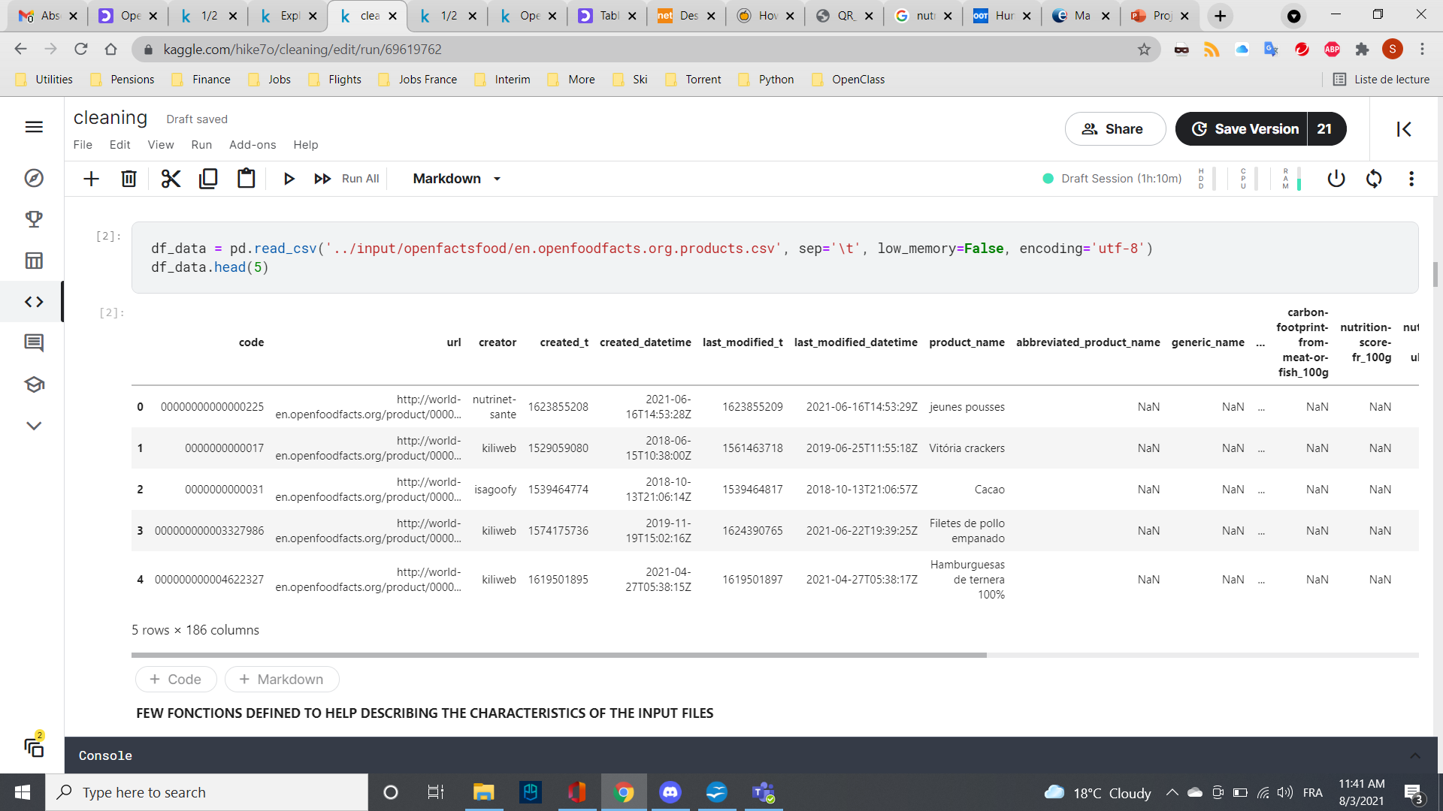
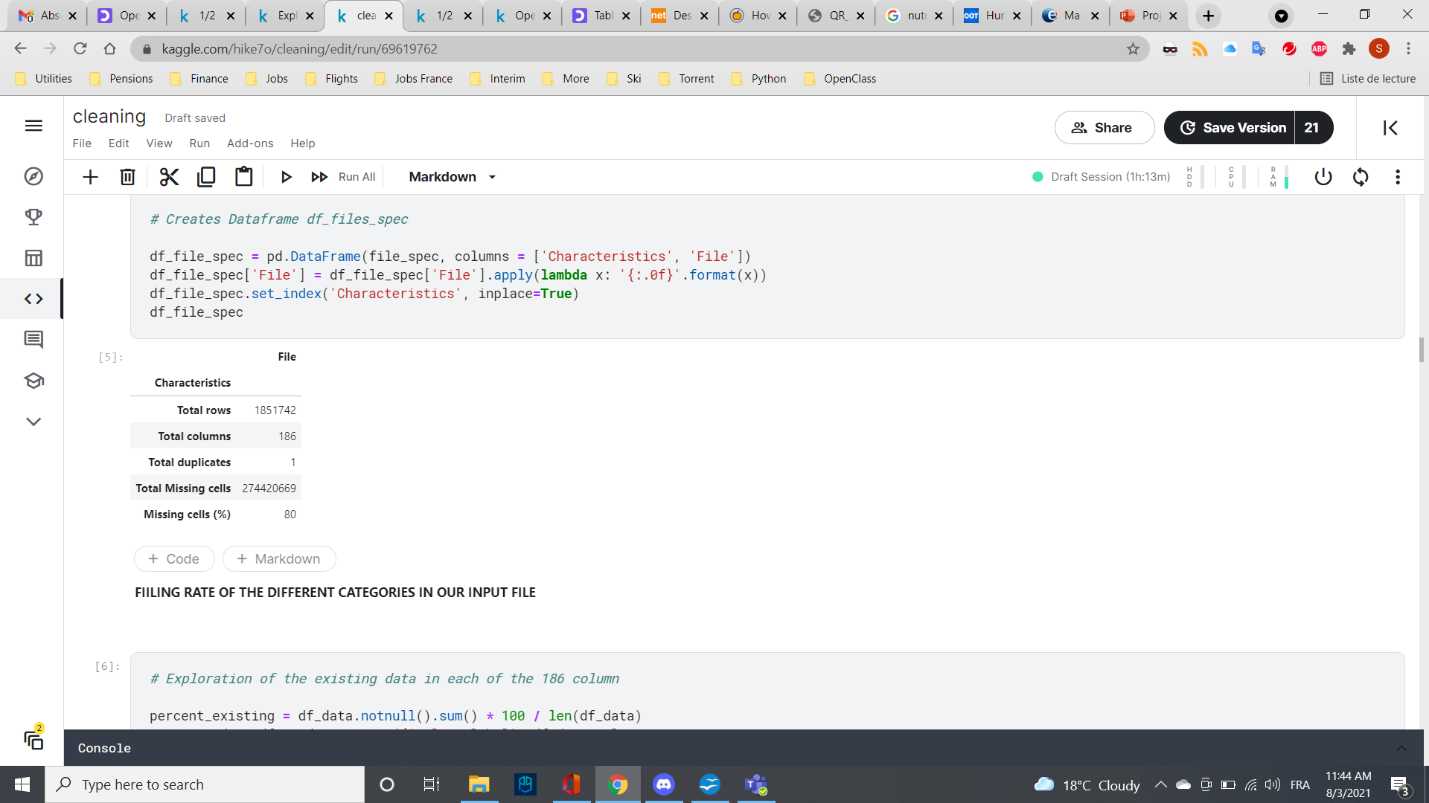
Data set available
Open Food Facts is a free, online and crowdsourced database of food products from around the world.
df_data = pd.read_csv ("OpenFoodFacts.csv")
df_data.head(5)

Slide 6
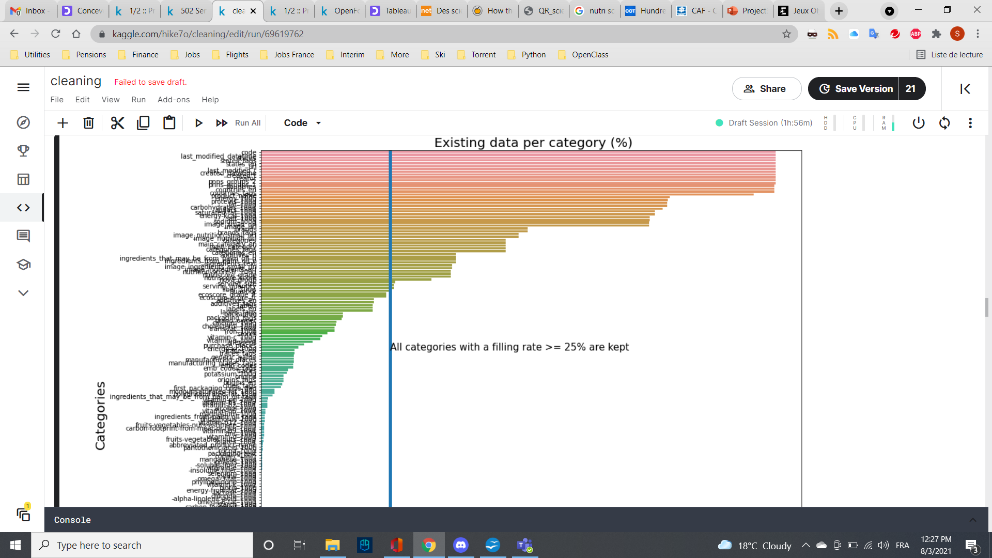
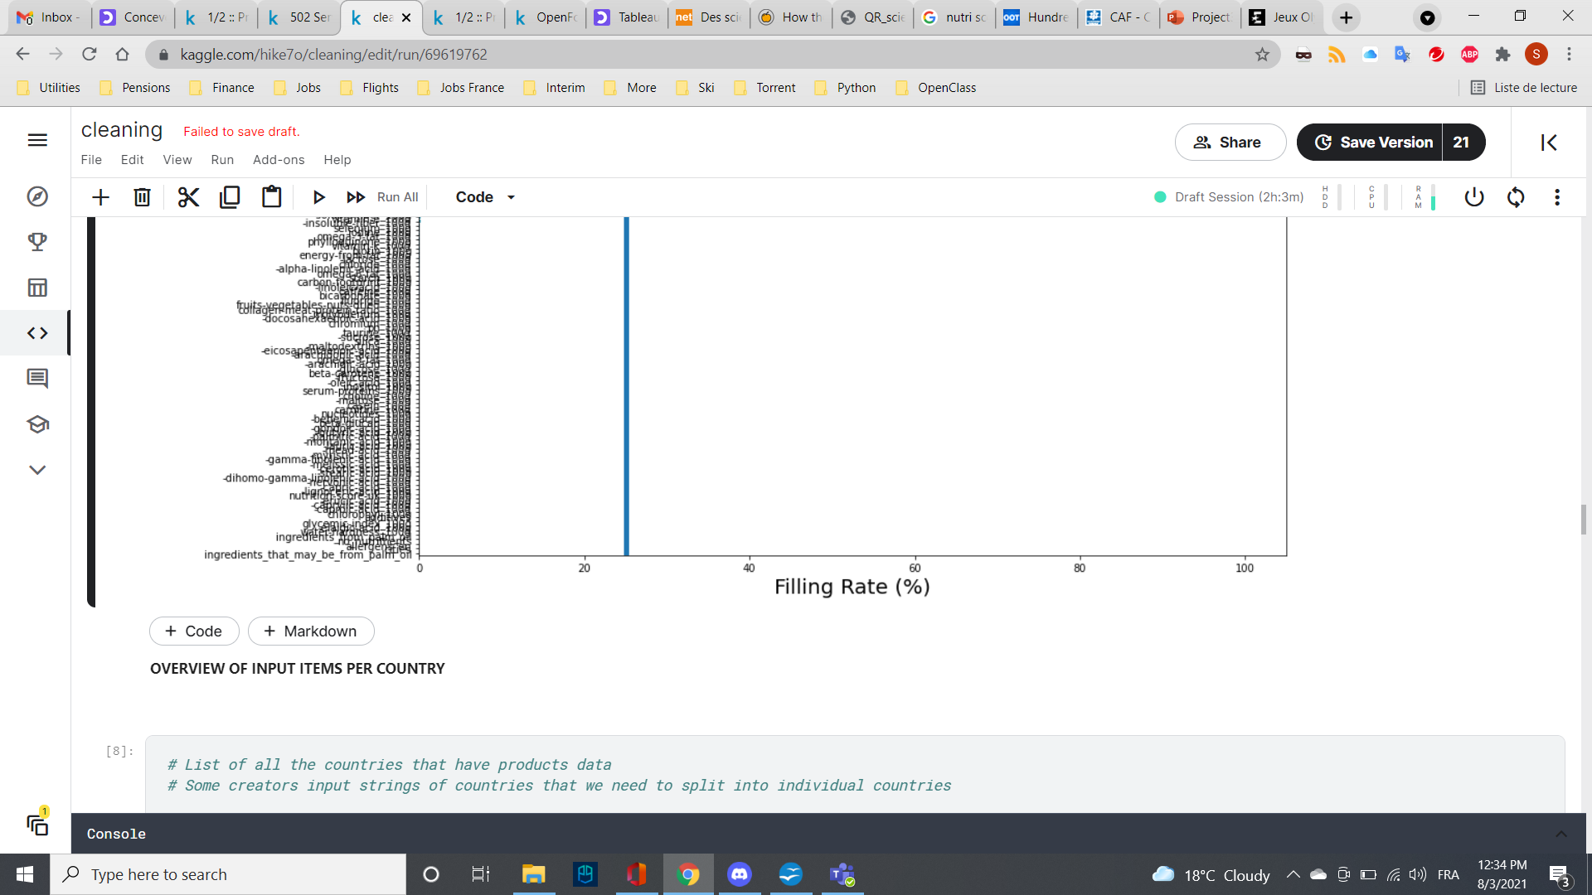
Data cleaning Phase 1: Filling rate
Removal of all columns with a filling rate < 25%
25% to keep Fibers category
Dataframe attributes reduction: 186 to 52

Slide 7
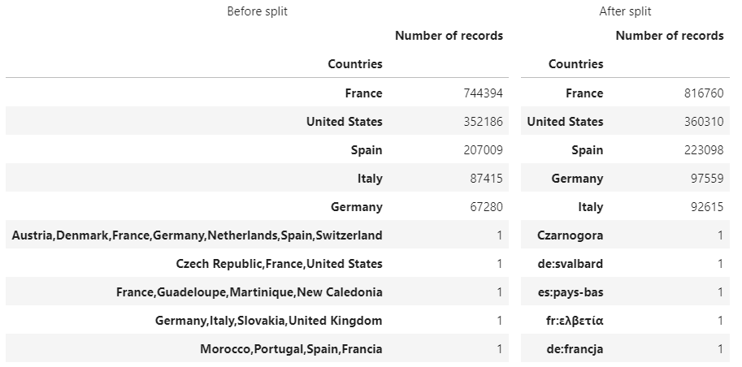
Data cleaning Phase 2: Country name
Different countries
Different input
Split strings by ",", stack and join
816k+ products in France
Dataframe tuples reduction 185k+ to 816k+
Focus on products available in France

Slide 8
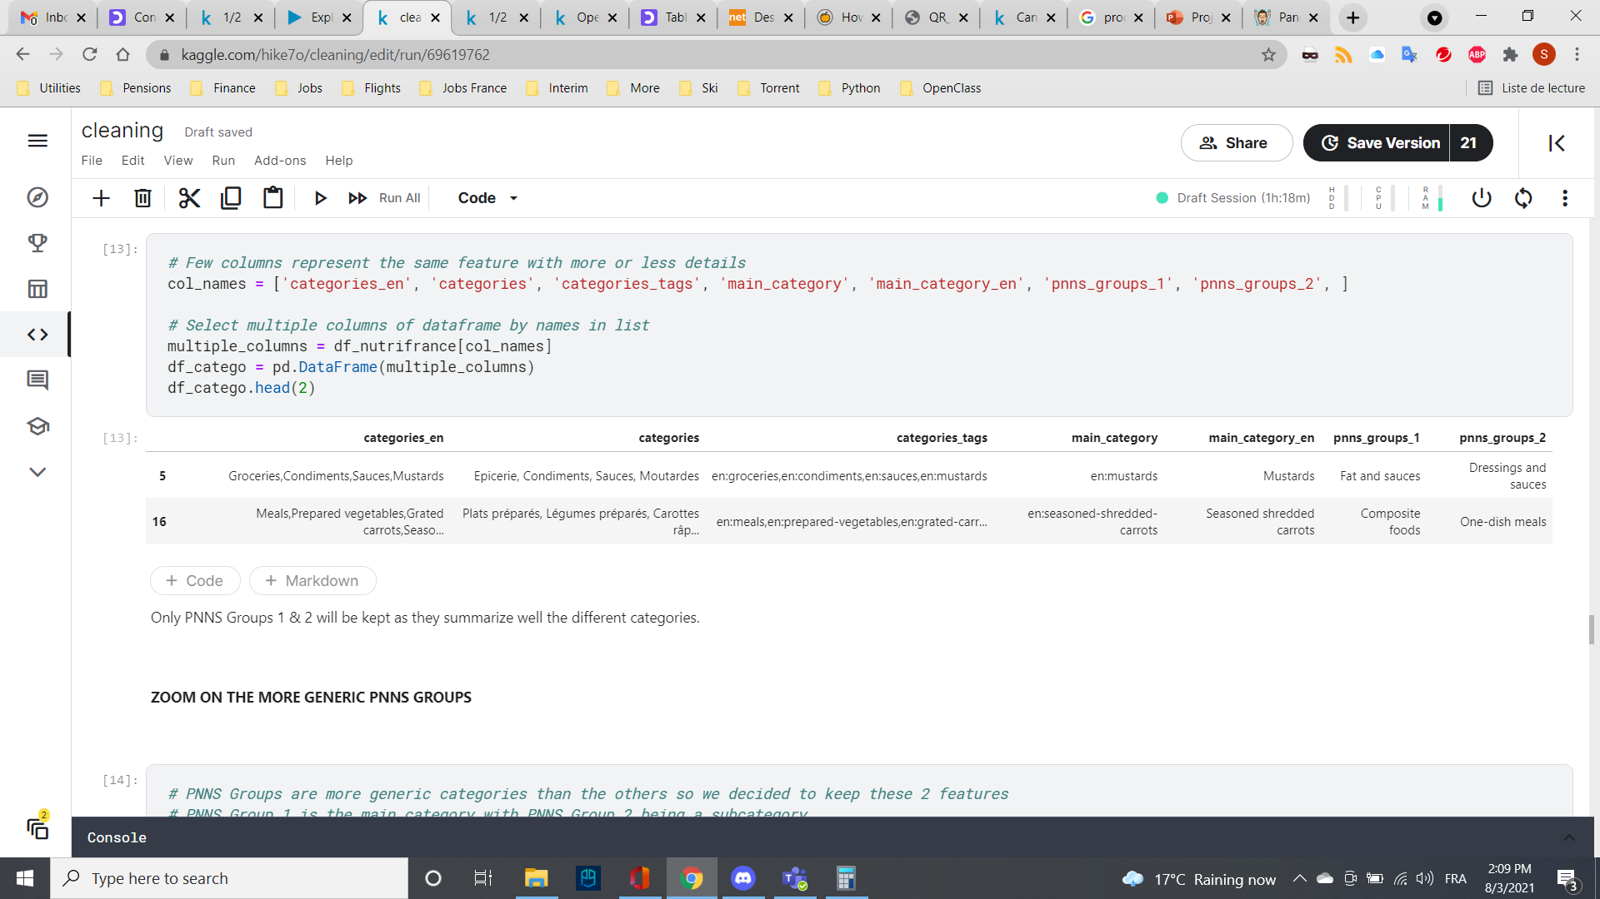
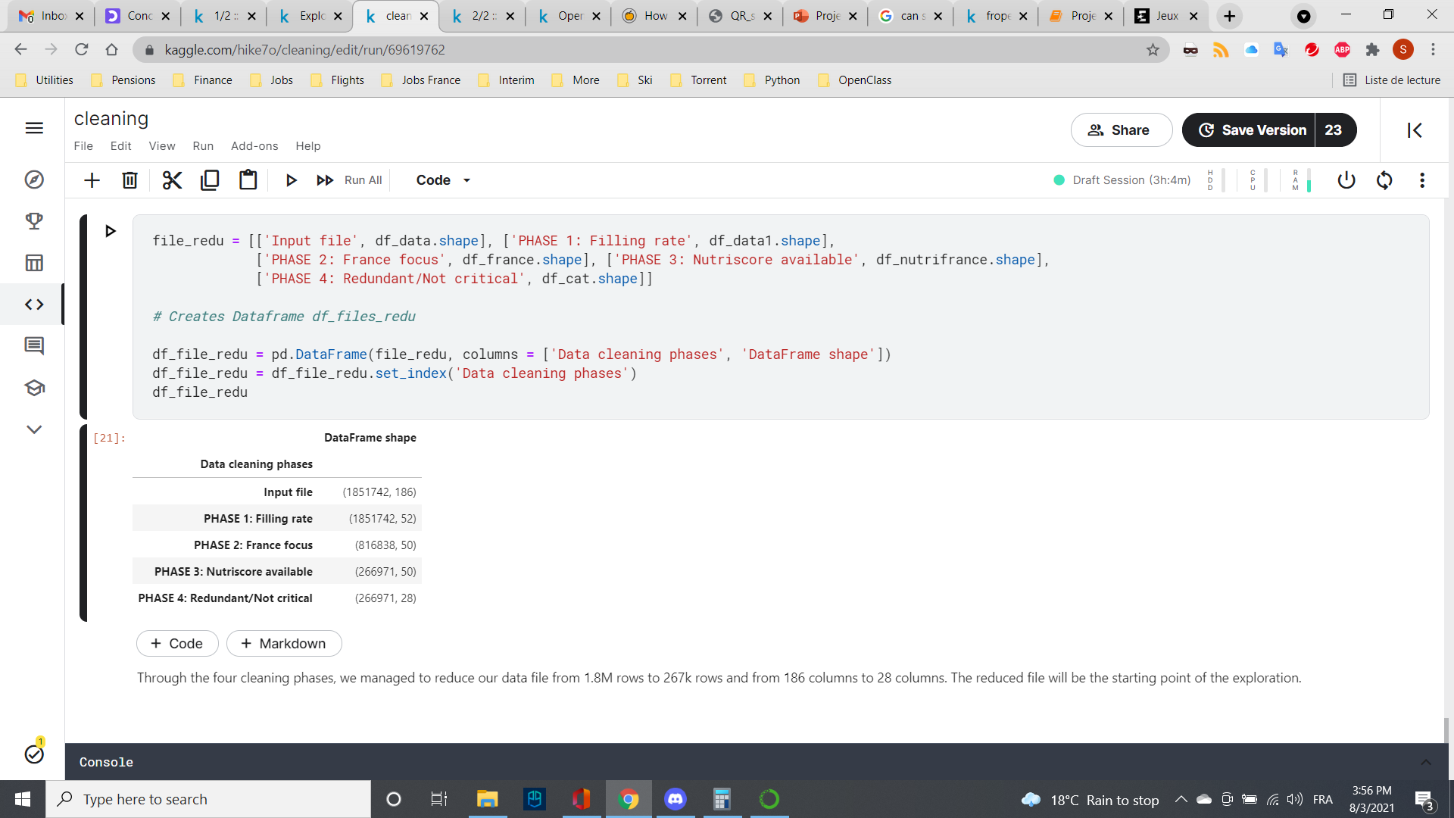
Data cleaning Phase 3/4
Focus on Nutriscore: Removal of all products with no Nutriscore information (Phase 3)
Removal of redundant products categories (Phase 4):
Removal of non-critical parameters:
additives_n
ecoscore_score_fr
created_t
….
created_datetime'
states_tags
Summary

Slide 9
Dataset Exploration

Slide 10
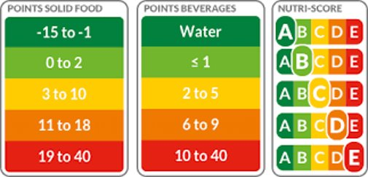
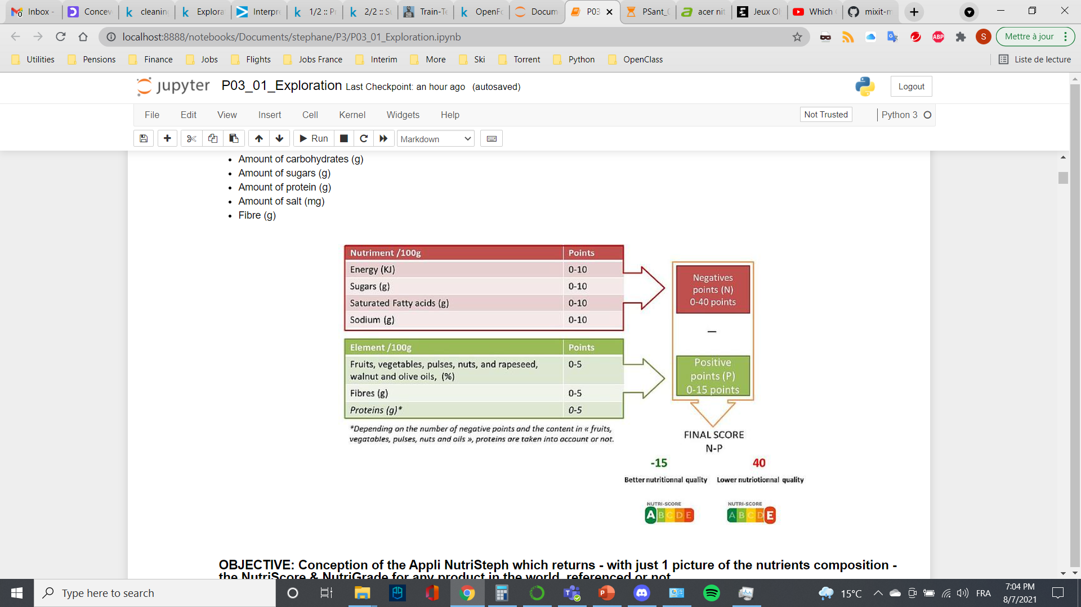
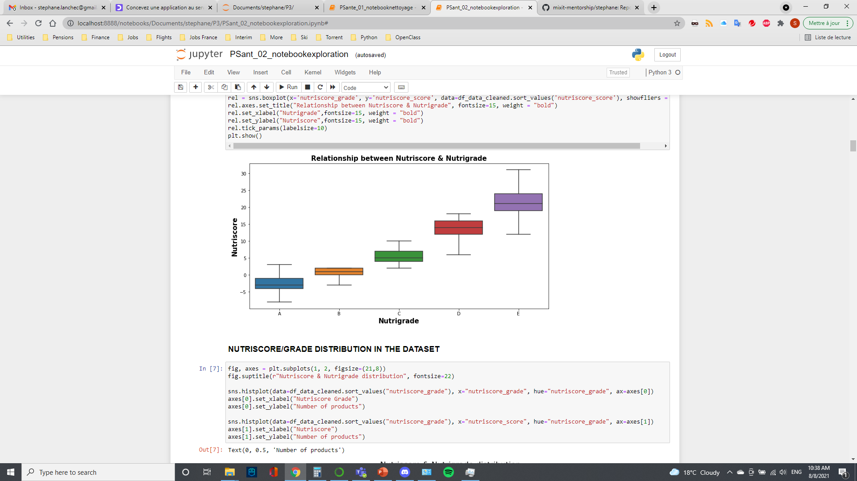
Products scoring and grading overview
Relationship between NutriScore and NutriGrade in the database

Slide 11
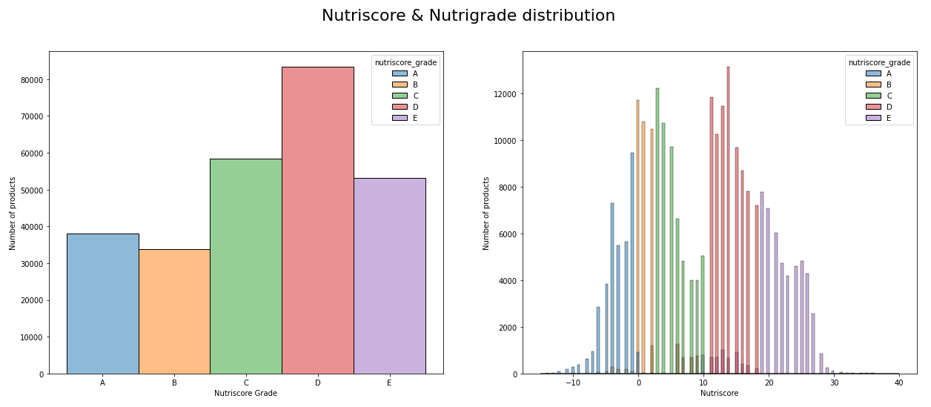
Products scoring and grading overview
Database governed by D grade products
Nutriscore in range with NutriGrade

Slide 12
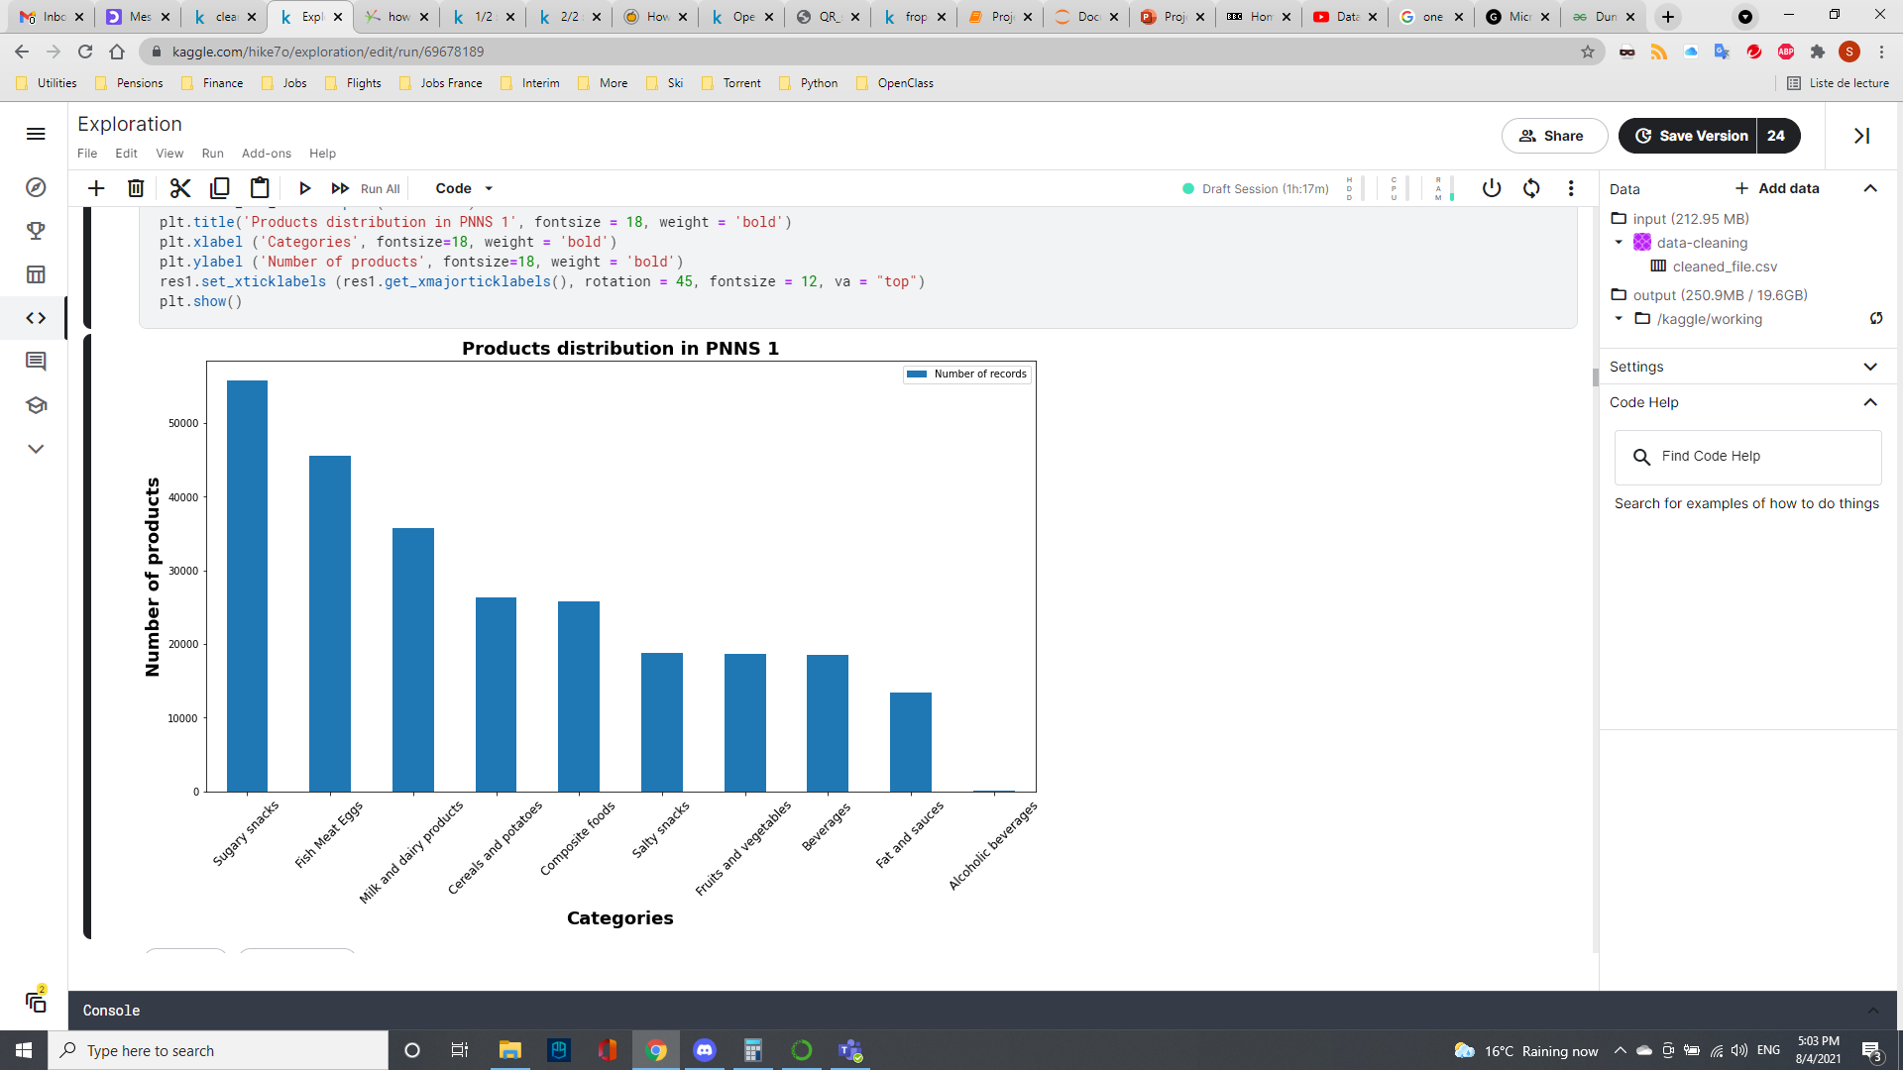
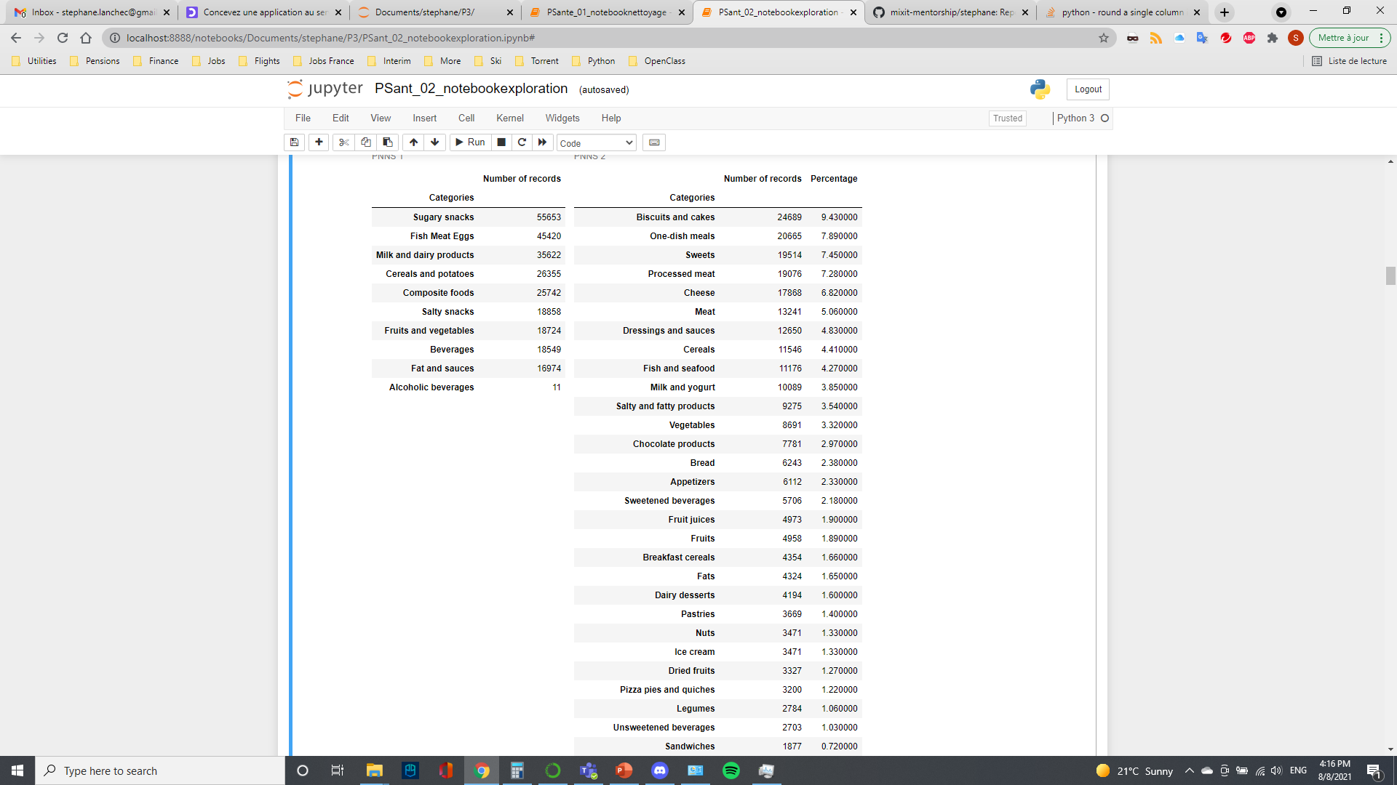
Products Categories Overview
PNNS 2
39 subcategories PNNS 2
Products are classified into 10 main categories PNNS 1
Most products are Sugary snacks or Fish Meat Eggs
Each PNNS 1 category is divided into some of the 39 subcategories from PNNS 2
.
.
.

Slide 13
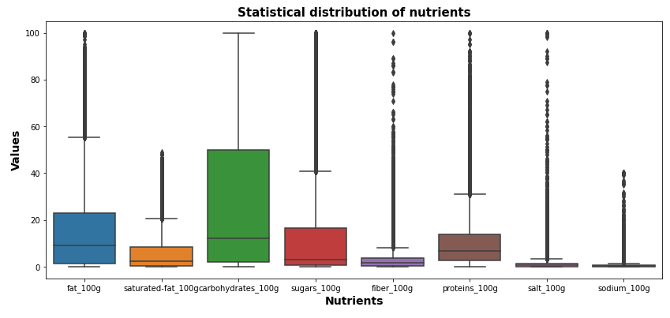
Nutrients distribution overview
Oil
Butter
Over 265k products
Focus on 8 nutrients:
Fat
Saturated fat
Carbohydrates
Sugars
Fiber
Proteins
Salt
Sodium
+ energy
Powder
Protein shake
Chocolate
Sugar
Jam
Salt
Stock cube
Soja sauce
Chocolate
Foie gras
Cheese
Organic
Peas
Outliers:
Numbers:
>60
3,000
>20
7,000
>50
19,000
>5
18,000
>35
2,300
>5
7,000
Outliers represent a small fraction of the number of products
Some products are true outliers observations (sugar=100, salt=100…), some are input errors

Slide 14
Examples of erroneous data
Product | Brands | energy | fat | saturated-fat | carbohydrates | sugars | fiber | proteins | salt | Actual value
Boudins blanc | Maitre Coq | 3690 | 17 | 5.4 | 4.9 | 2.7 | 0 | 9.5 | 1.3 | 882
Pistaches grillees a sec | Rochambeau | 2523 | 49 | 49 | 11.3 | 6.4 | 0 | 24.7 | 1.7 | 6.7
Sauge des alpes | Ricola | 983 | 0 | 0 | 97 | 0 | 96 (value for polyols) | 0 | 0 | 0
Cream crackers | Morrissons | 1849 | 14.3 | 6.5 | 67.2 | 1.6 | 3.1 | 97 | 1.26 | 9.7
Californian almonds | Happy Belly | 2489 | 49.9 | 3.8 | 9.1 | 4.2 | 12.5 | 21.2 | 20 | 0.02
Typo errors by users
Values input by mistake
Mix of true values and error input
We decided to keep them for now

Slide 15
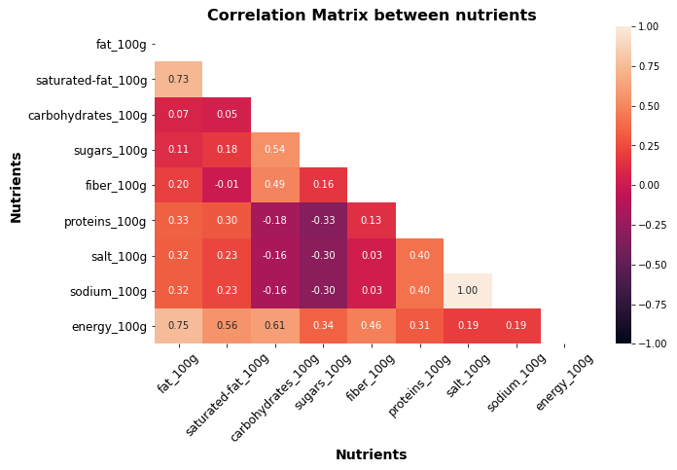
Correlation Matrix Heatmap
Perfect positive correlation
Salt & sodium
Strong positive correlation
Energy, fat and saturated fat
Relatively strong positive correlation
Carbohydrates & sugars
Medium positive correlation
Carbohydrates & fibers
Weak positive correlation
Proteins & salt/sodium
No correlation
Sugars & fibers

Slide 16
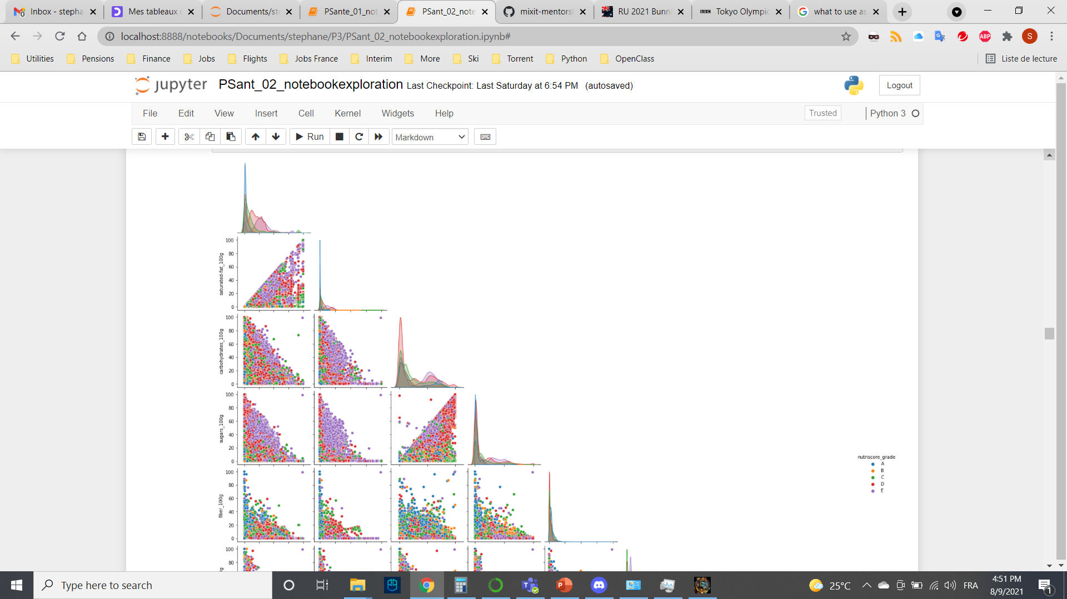
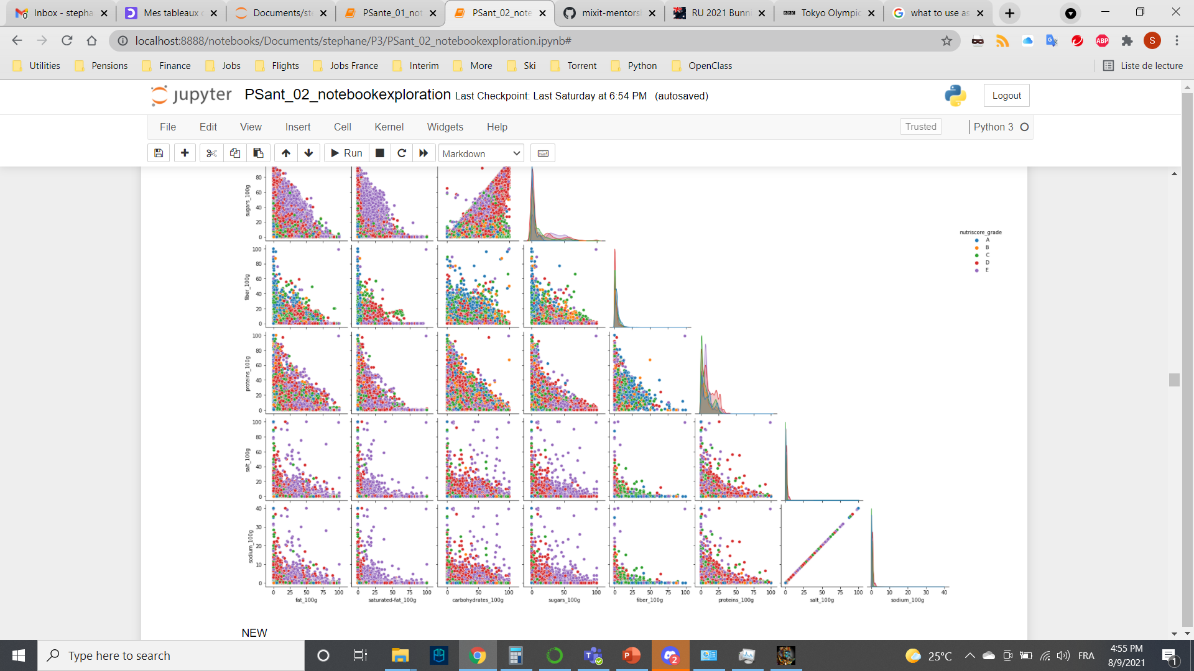
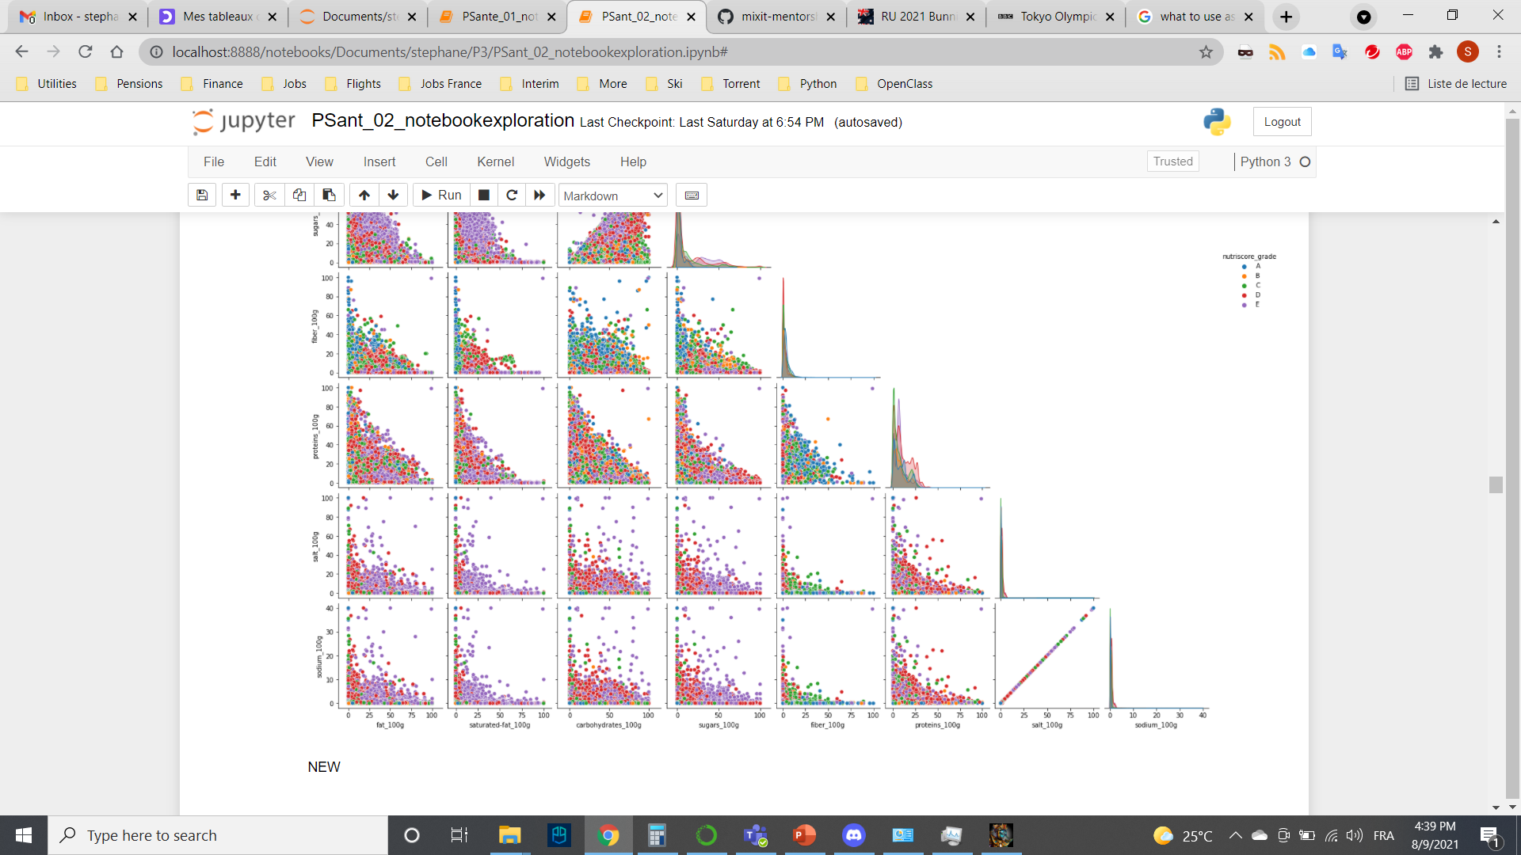
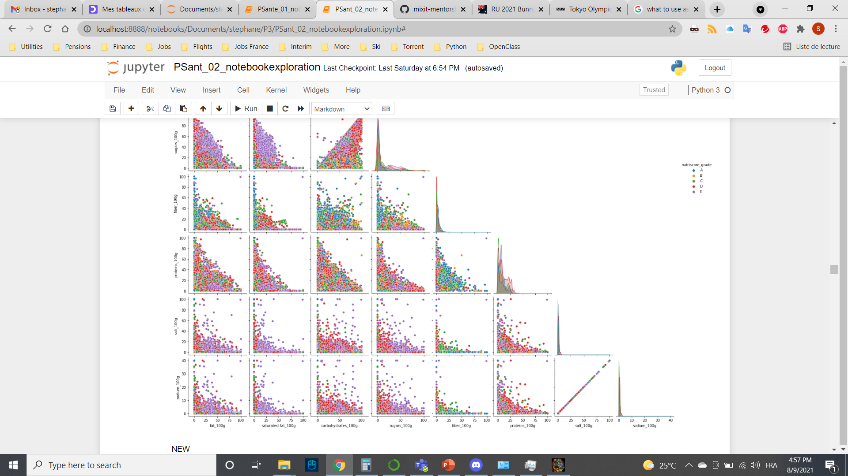

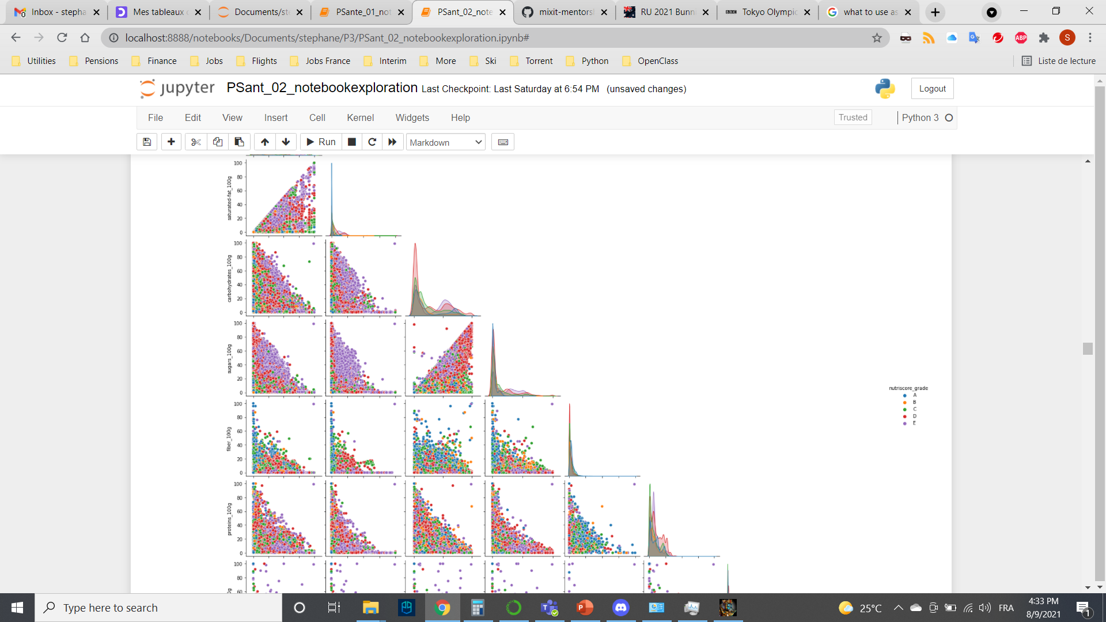
Multivariate Analysis
From pairplot, few indications
Low fats & Fibers correlate with
Grade A
High Sugar correlate mostly with
Grade D &F

Slide 17
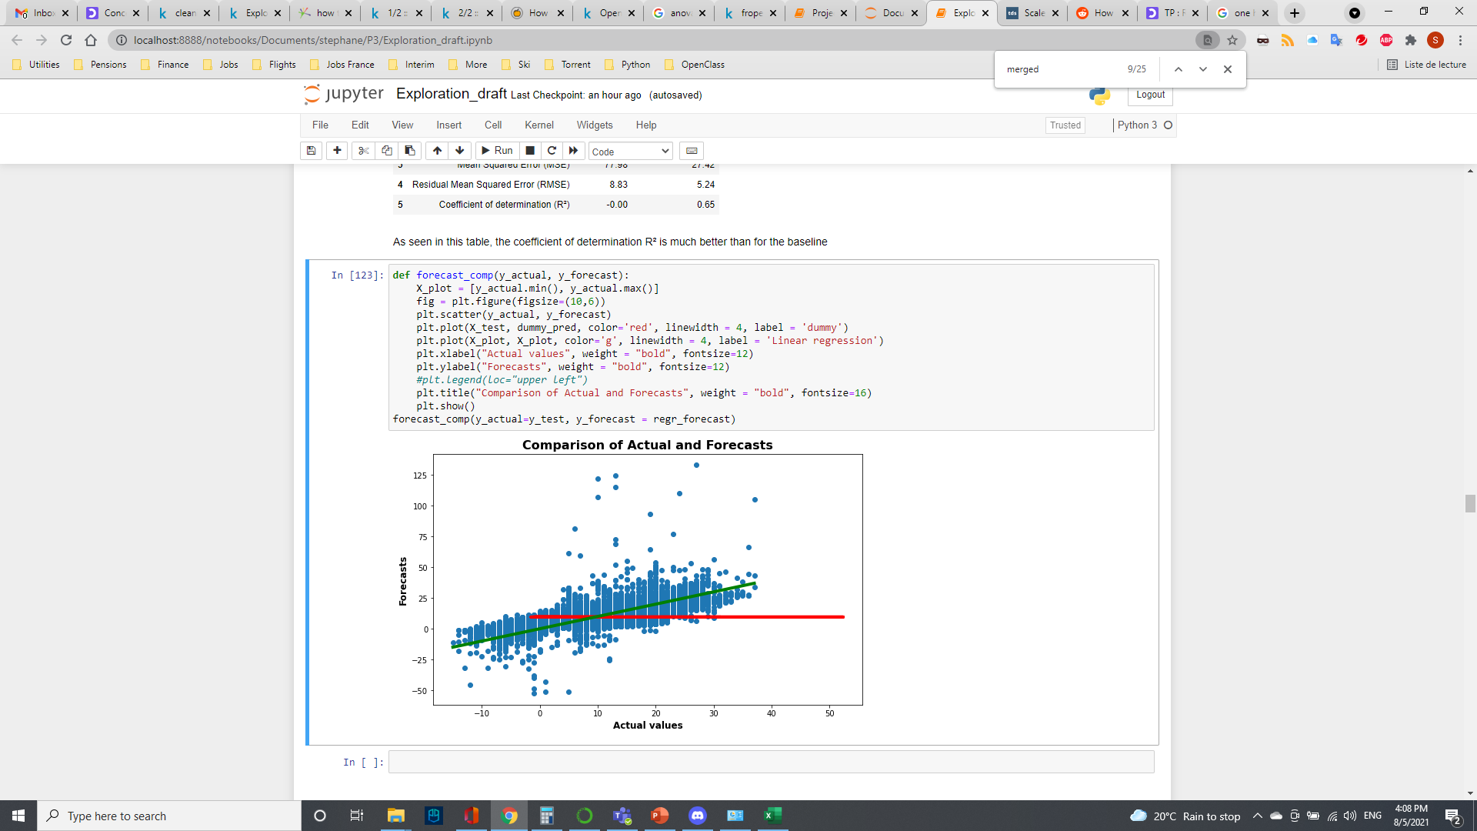
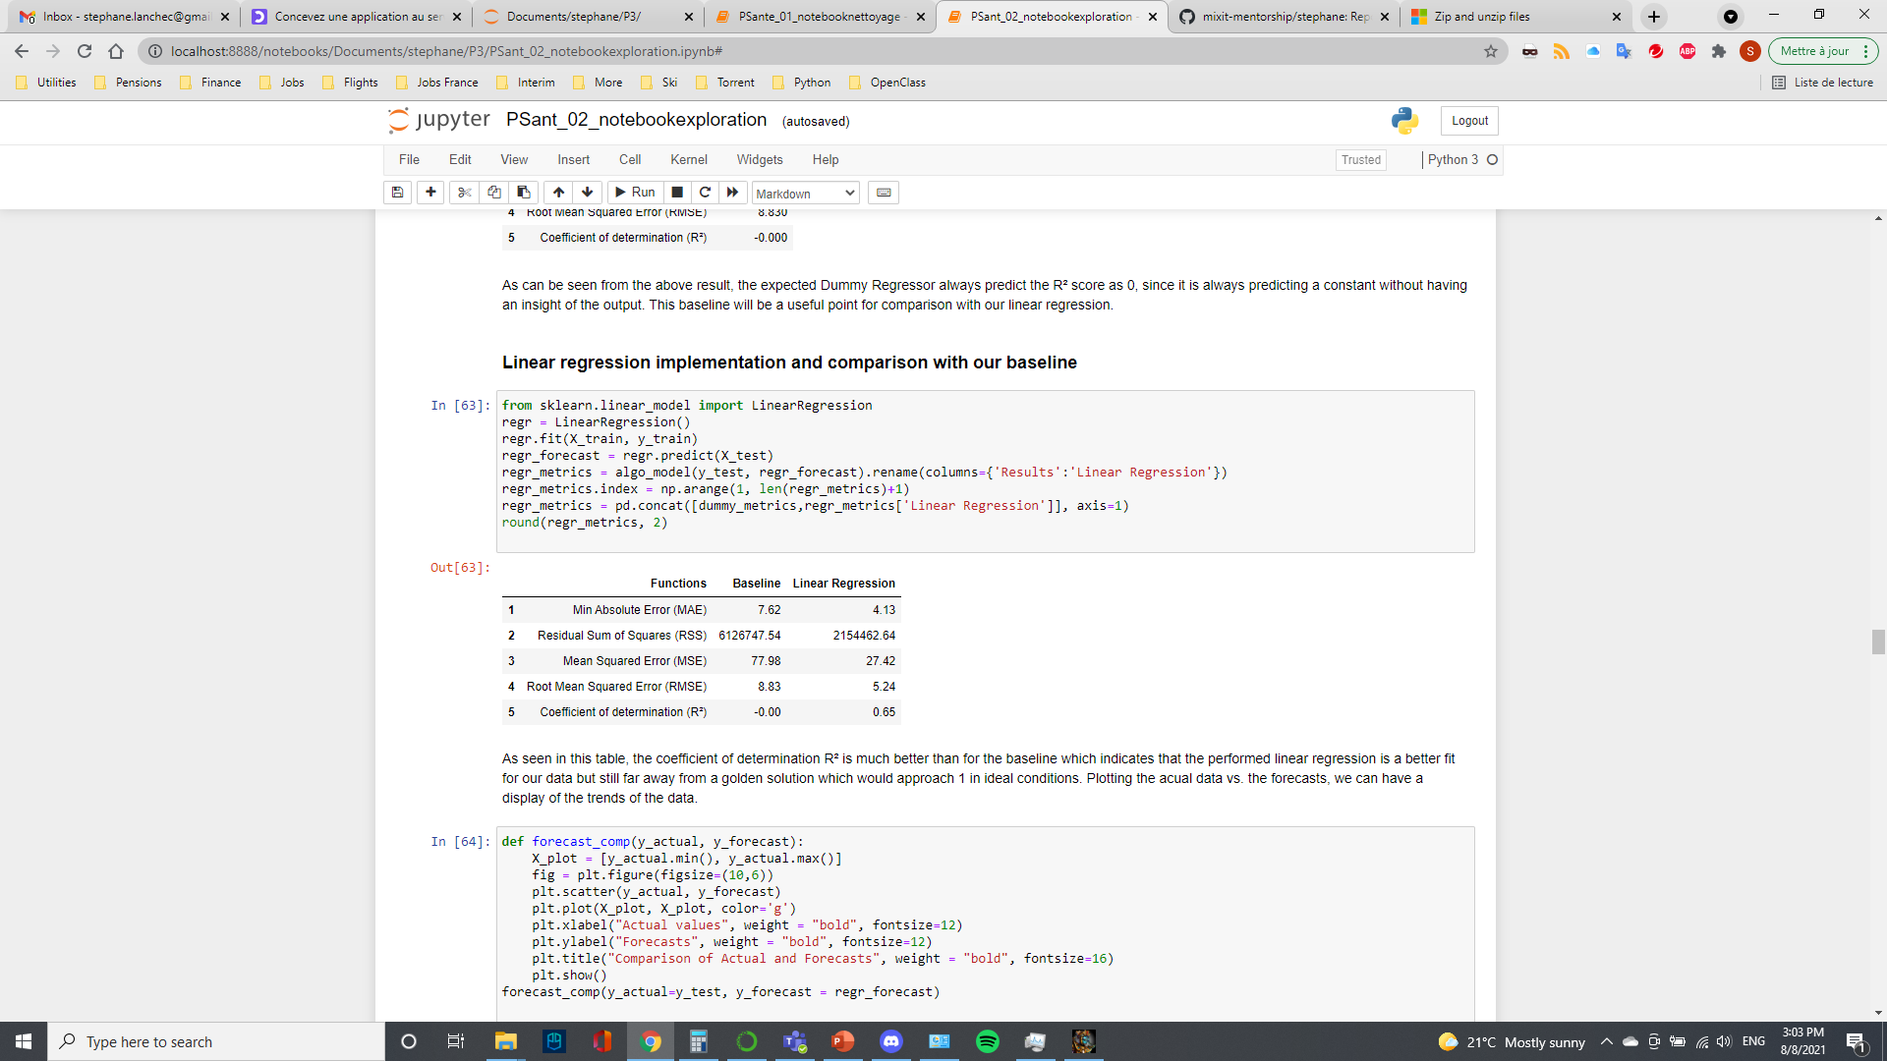
Multivariate linear regression
Linear regression vs. Dummy regression (baseline)
Coefficient of determination: how well the regression model fits the actual data
R2 = 0.65, scattered data between actual & forecasts
Linear regression
Baseline

Slide 18
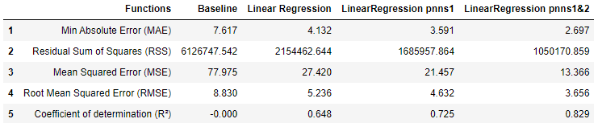
Second regression: One Hot Encoding
ANOVA performed showed PNNS groups have an impact on Nutriscore
Incorporation of categorical values PNNS Group 1 & 2 into regression
Improves the coefficient of determination to 0.83

Slide 19
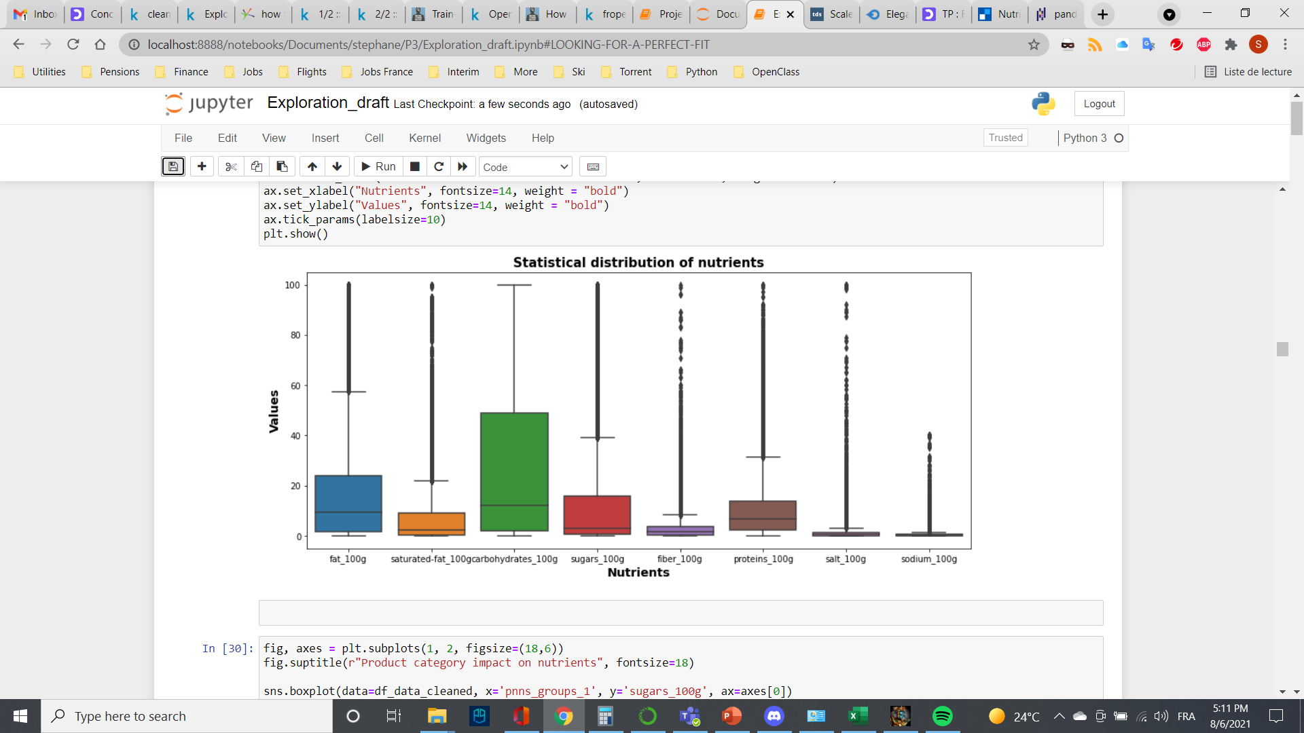
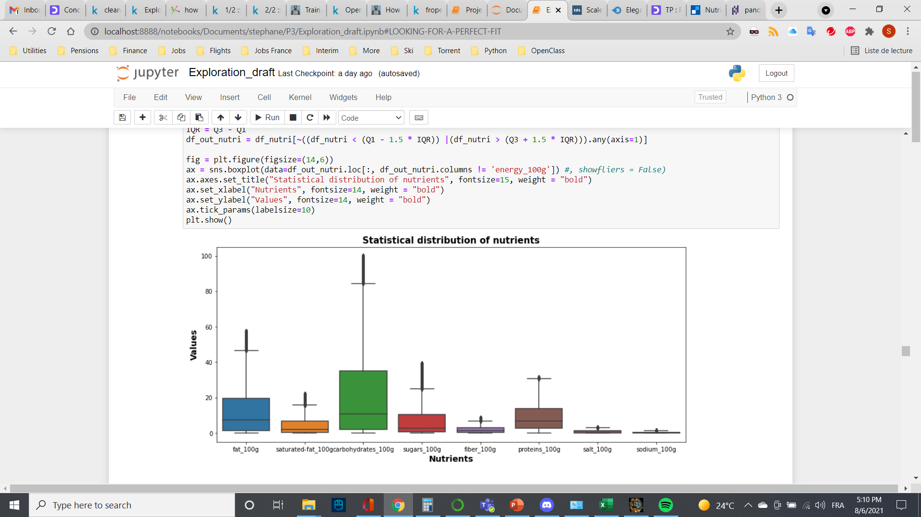
Outliers impact
Scattered data due to outliers
Interquartile range method
Removal of all pure products & true outliers (65k over 265k products)

Slide 20
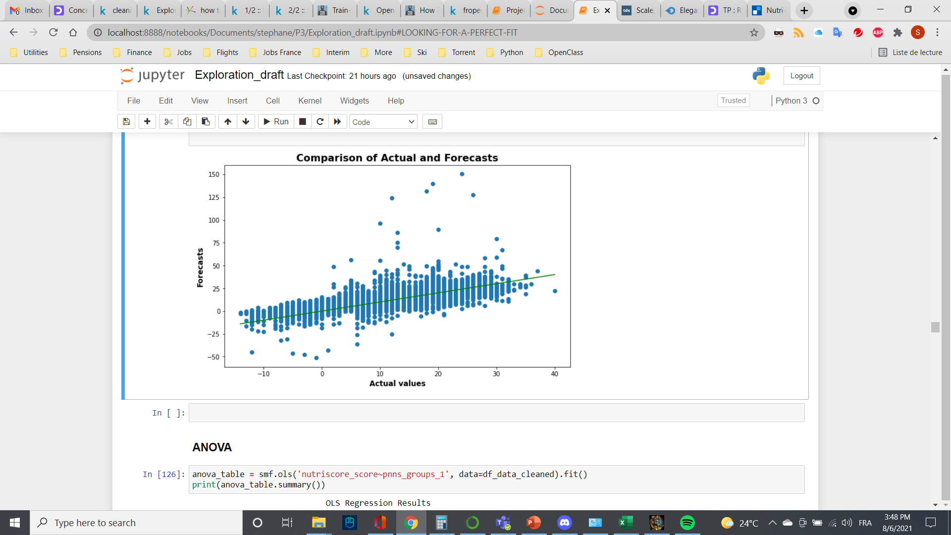
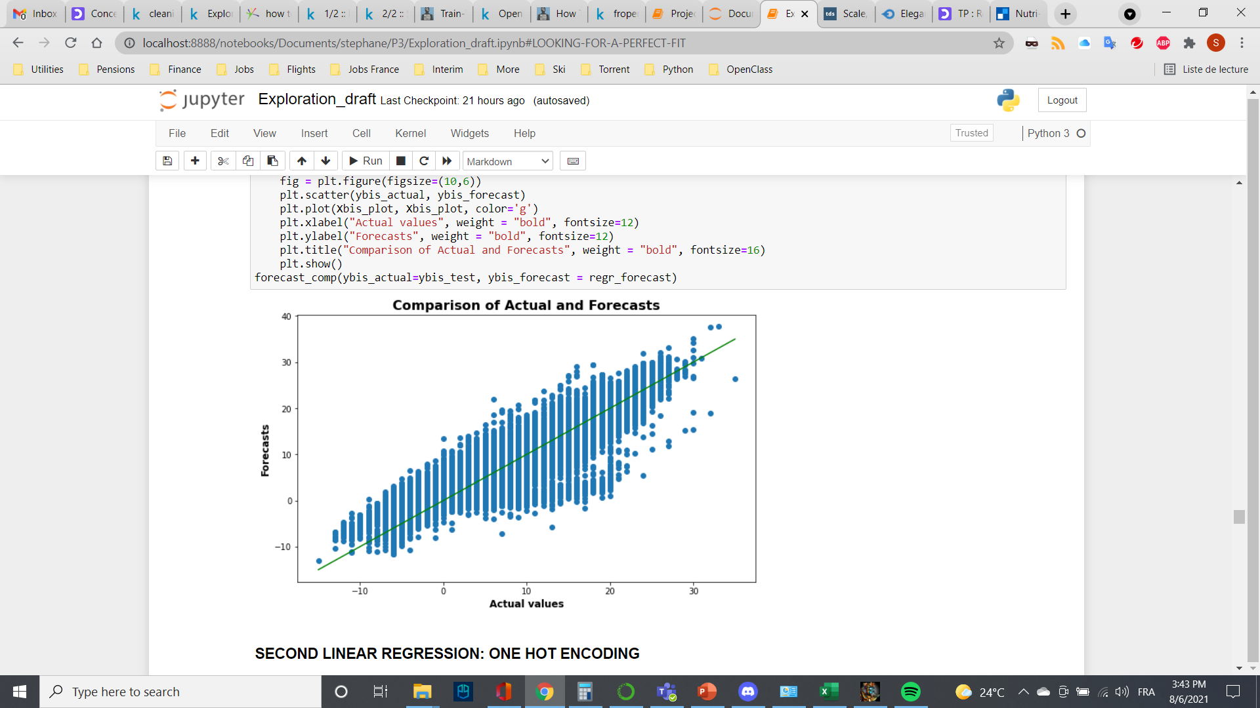
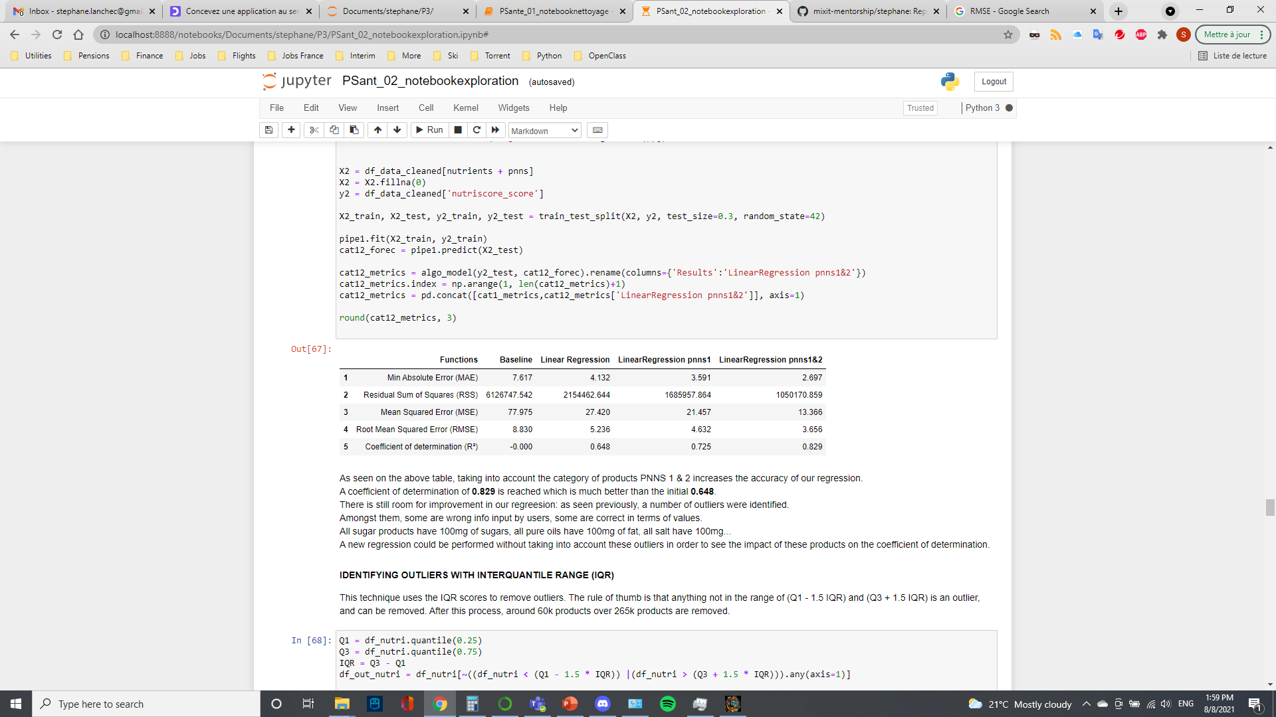
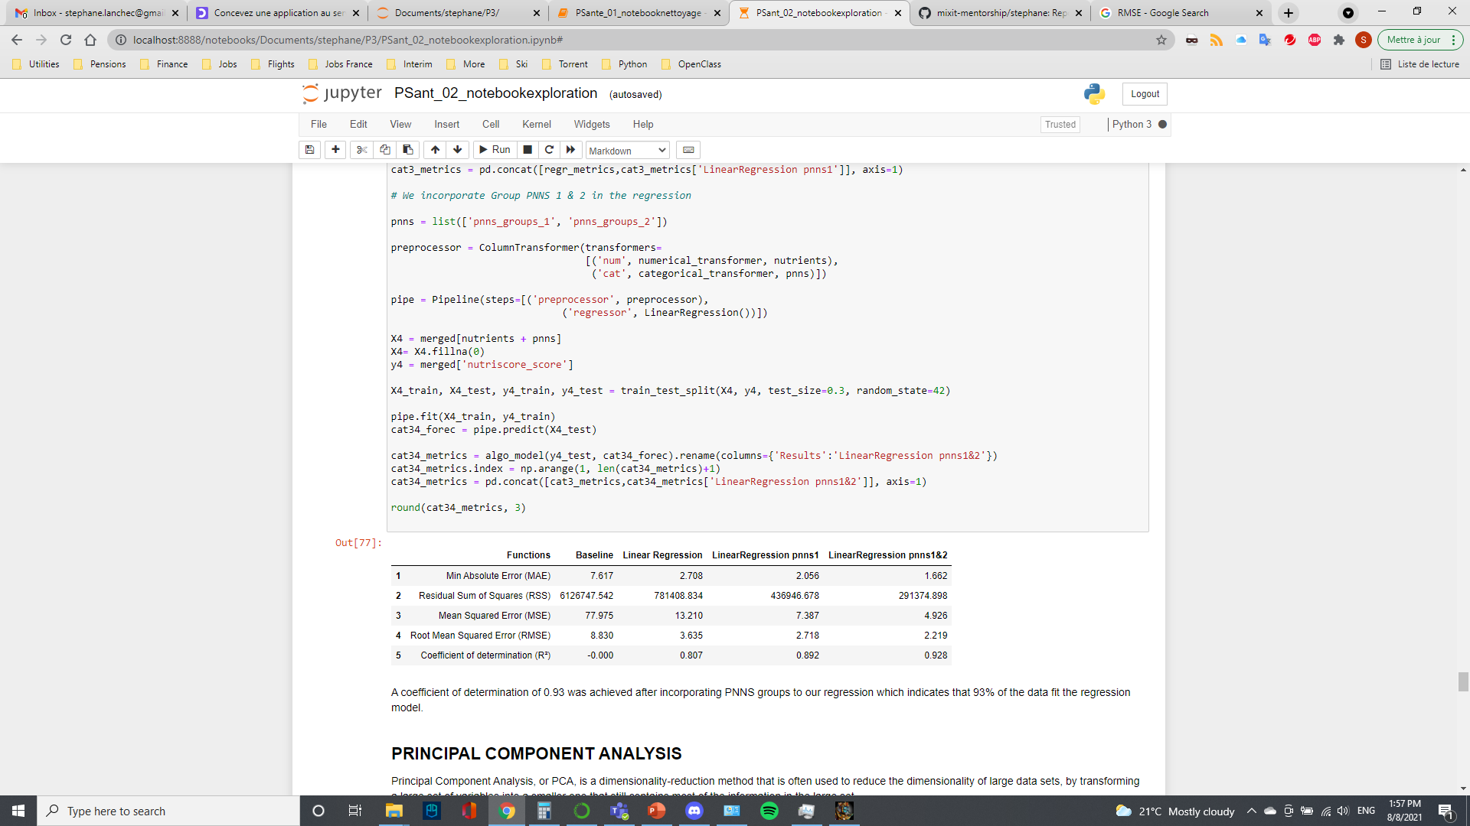
Regression improvement
With outliers R² = 0.83
Without outliers R² = 0.93

Slide 21
Discussions
An algorithm based on linear regression and one hot encoding has been performed to relate nutrients and category to the Nutriscore/Grade
Adding the products category to the nutrients in the model improves the performance of the model
The coefficient of determination increases from 0.80 to 0.93
Investigation of different regressions possible: Ridge, Lasso…in order to estimate the impact
Work would still need to be done on identifying labels from different countries (serving size in the US v 100g in Europe…)
Might need to work on subcategories like olive oil for instance graded D then C (misclassification of many foods through Nutriscore)

Slide 22
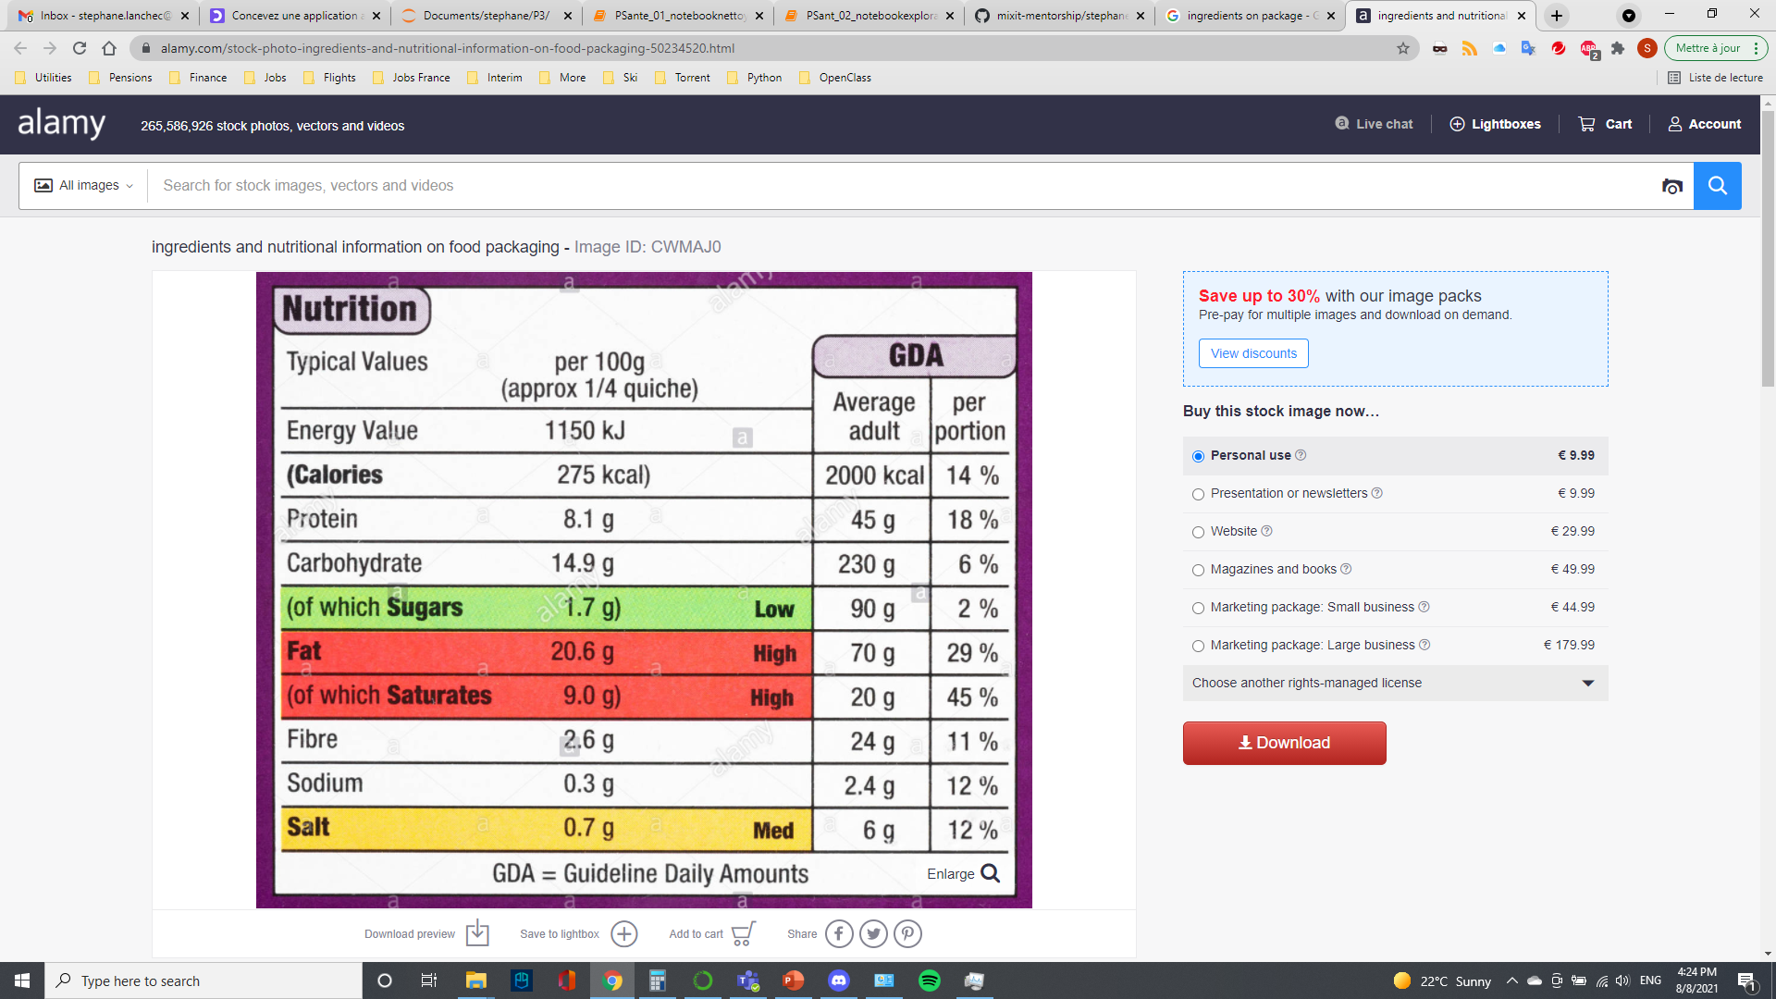
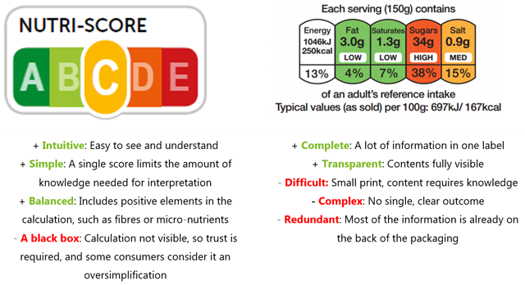
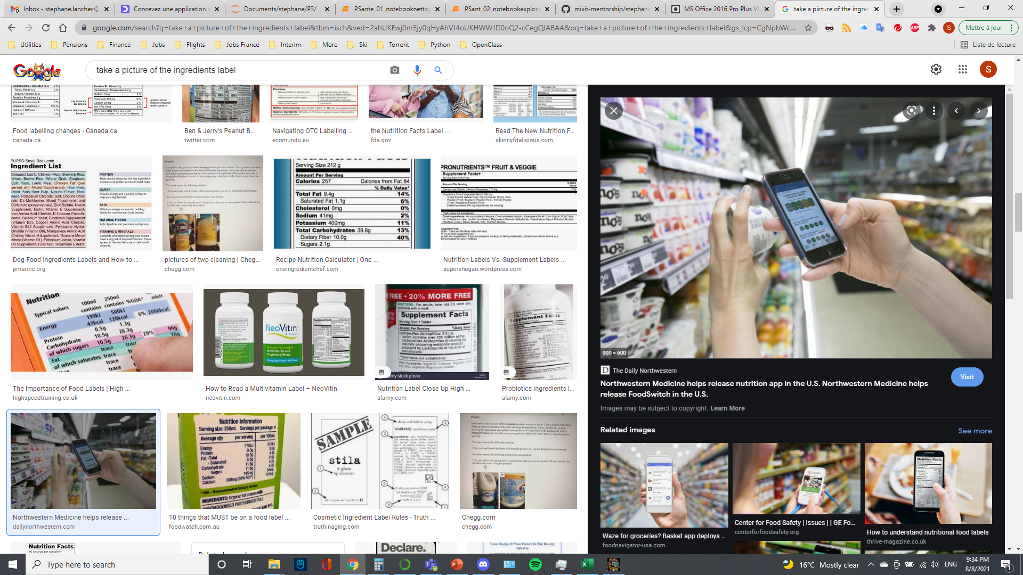
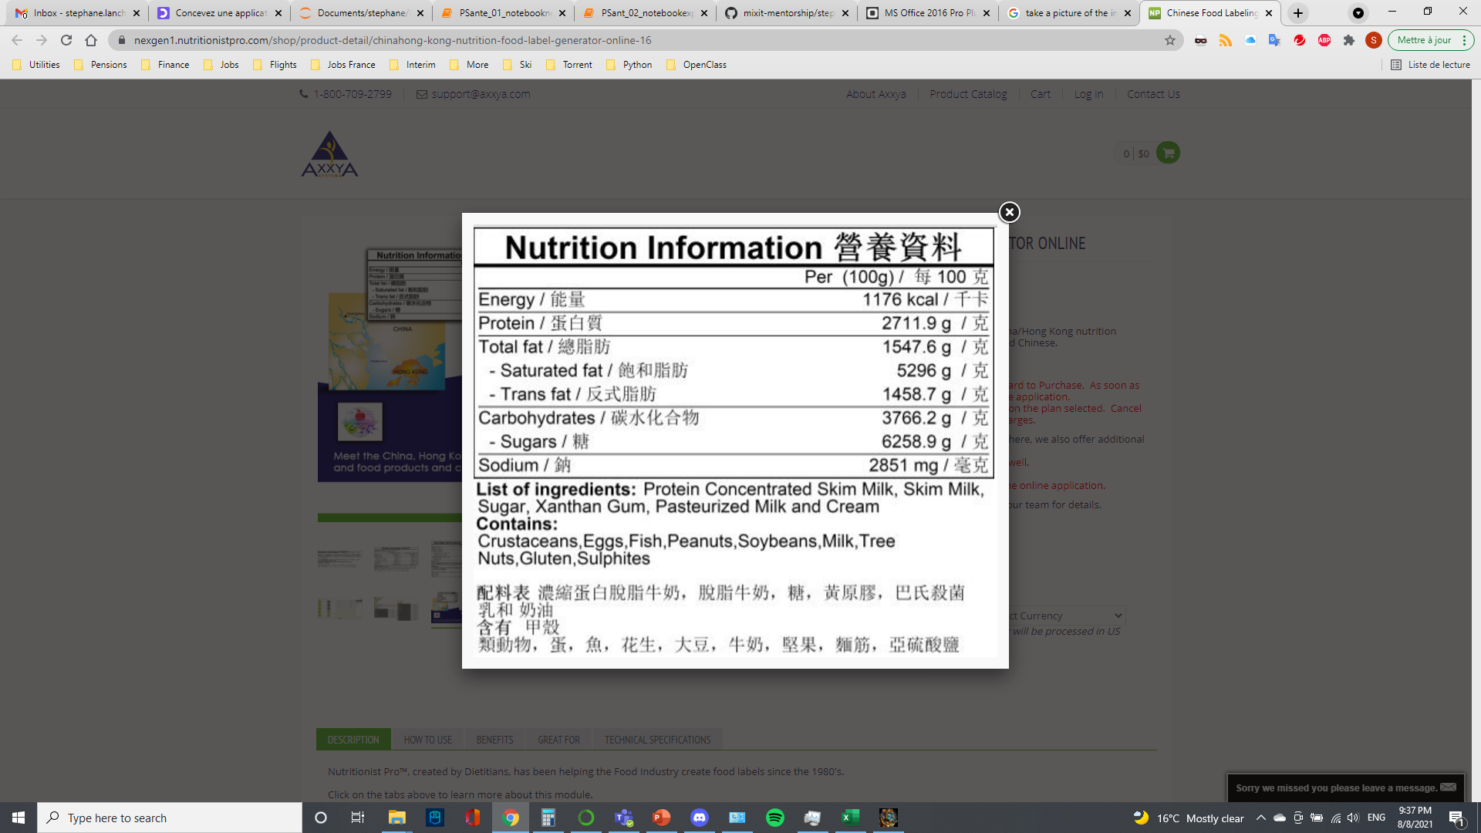
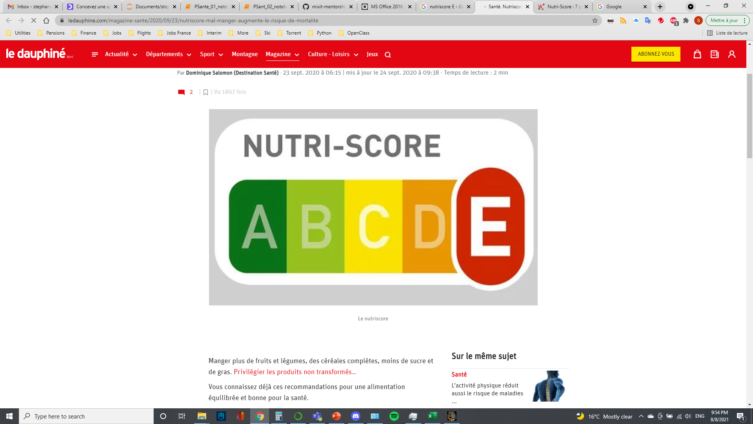
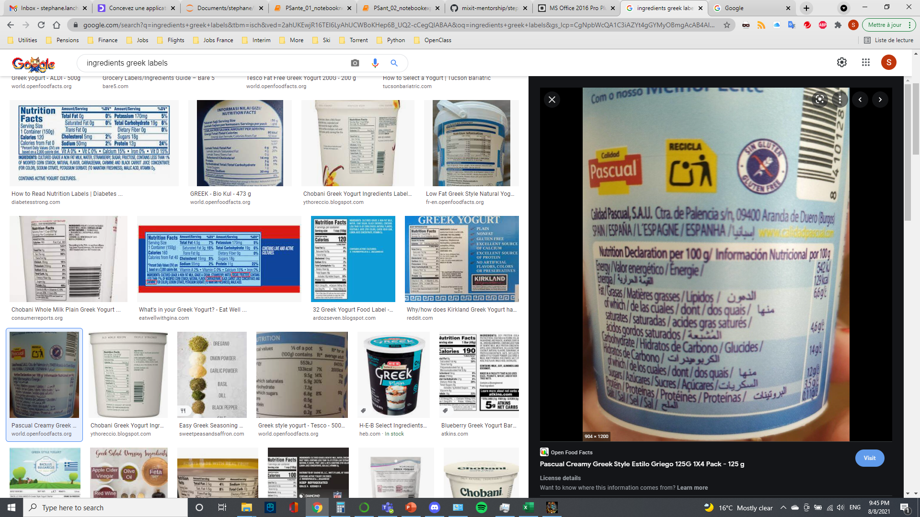
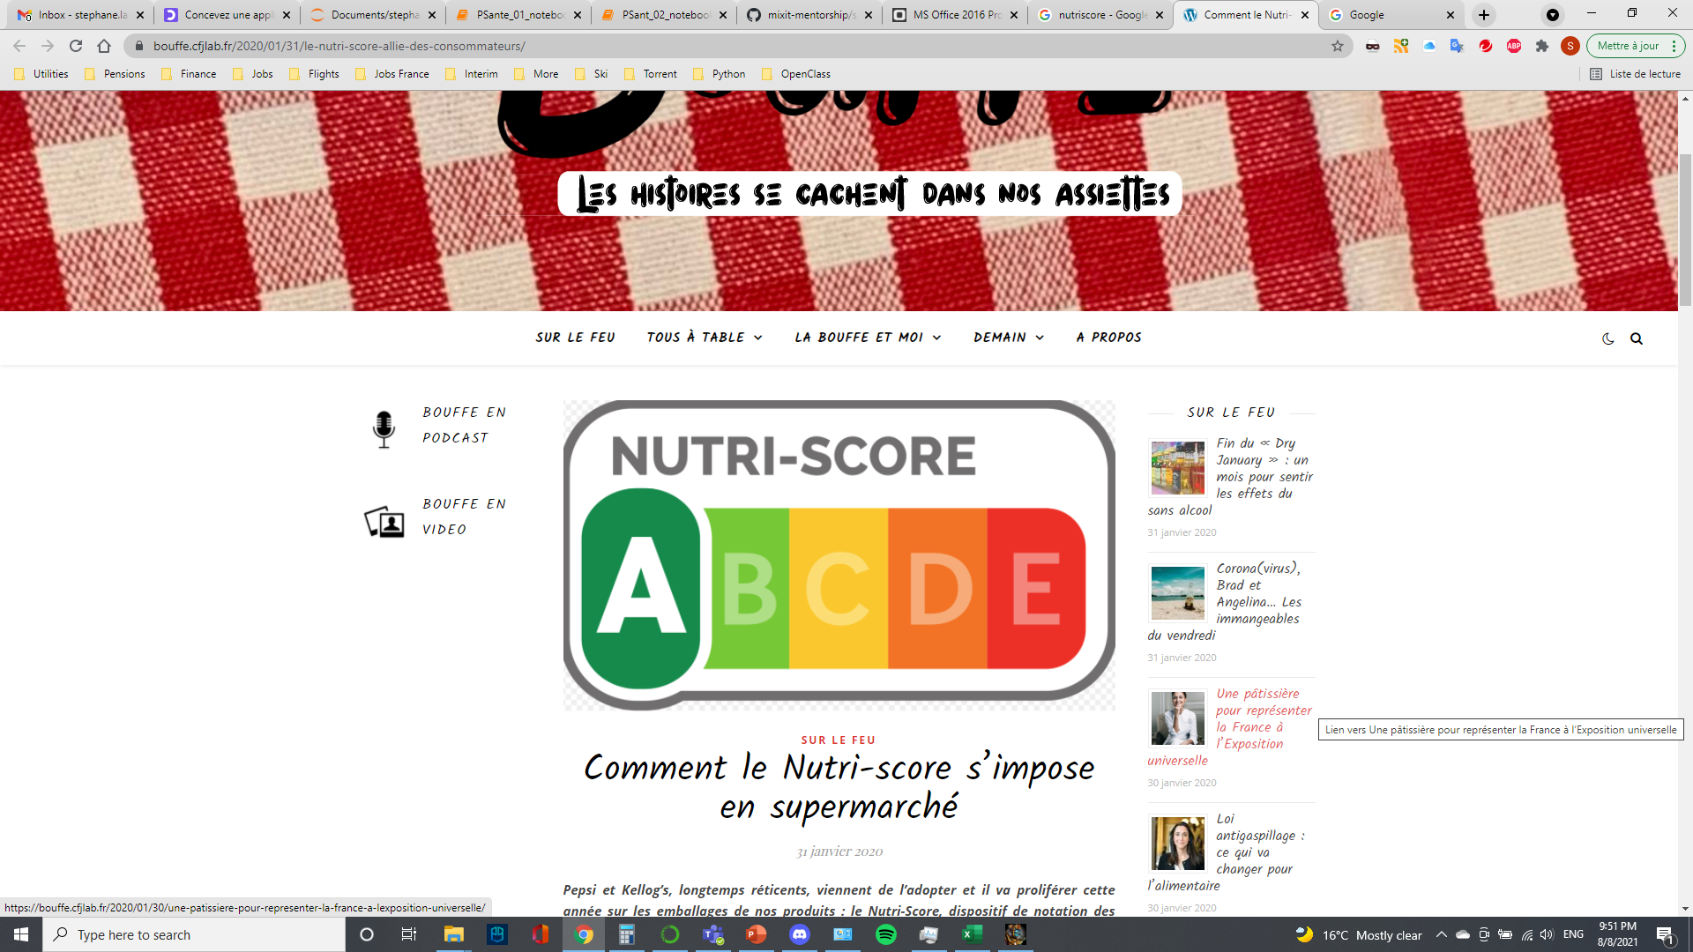
Conclusions

Slide 23
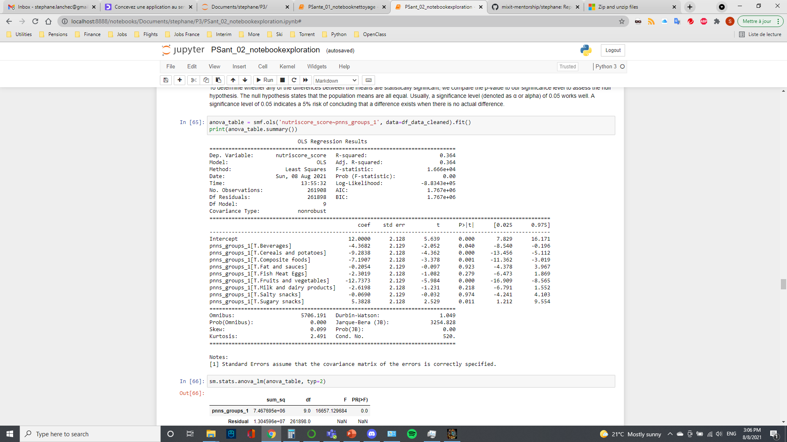
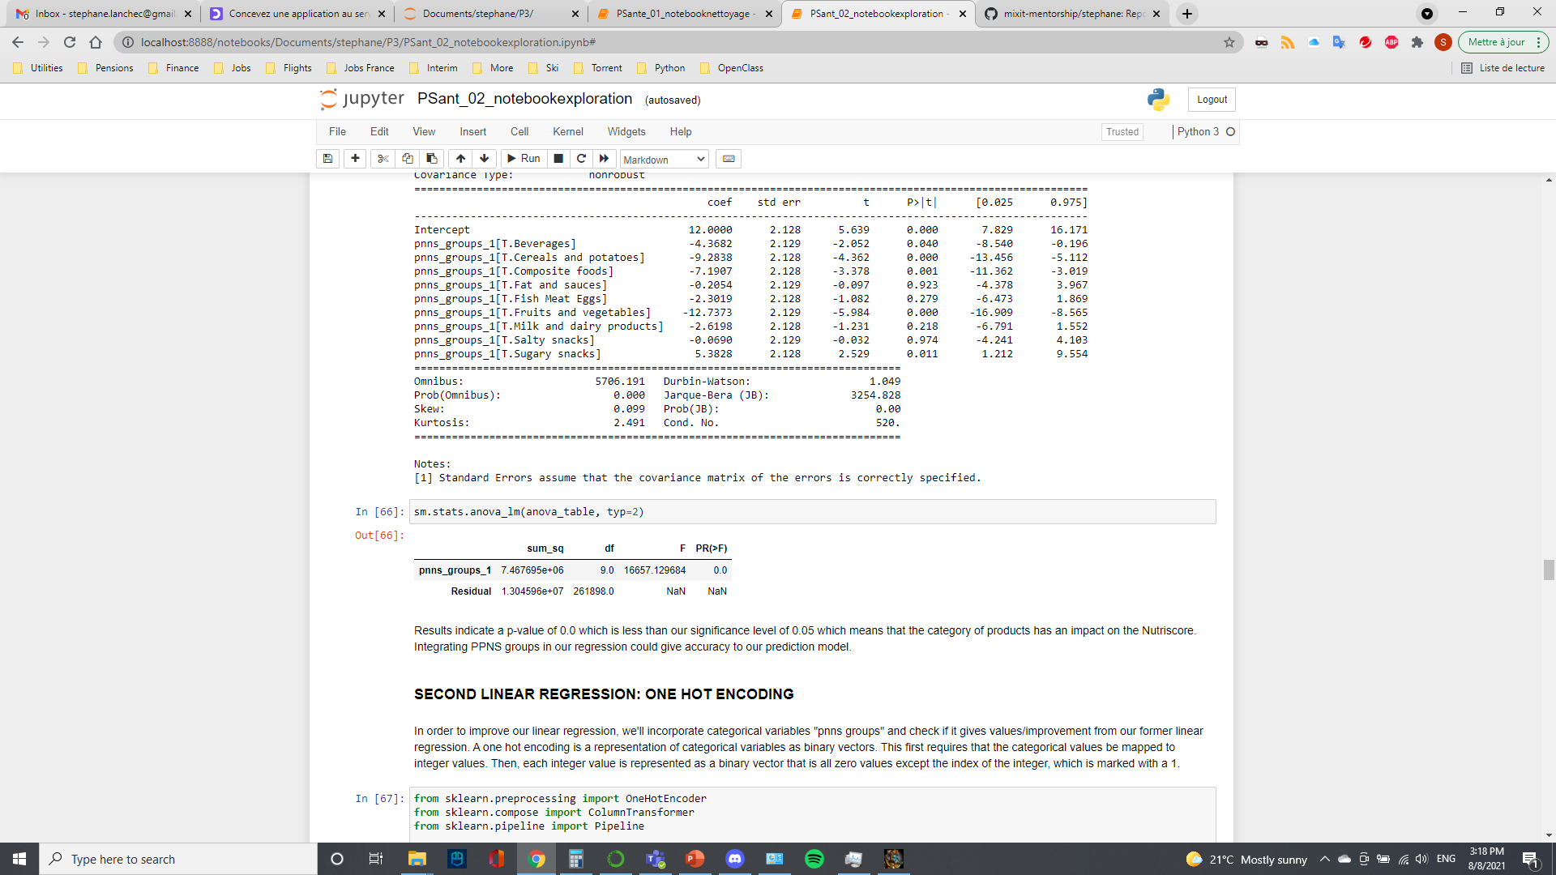
ANalysis Of VAriance
ANOVA between NutriScore and PNNS Groups
p-value of 0.0 which is less than our significance level of 0.05
Category of products has an impact on the Nutriscore

